Slide 1
www.europeanspallationsource.se
15 October, 2018

Slide 2





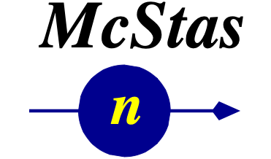
McStas-Mantid and the neutron pipeline
October 2018
Neutron Transport
Source
Guide
Sample
Detector
Reduction
Analysis
Typical McStas Neuron Transport
Mantid-McStas focus:
How to analyse McStas data
ORNL McStas workshop, October 18th-19th 2018

Slide 3
Motivation: I - Highlevel
October 2018
Mantid is well established software – long history
McStas is well established software – long history
Wanted to combine the reduction framework and the neutron transport framework
So users can do transport, reduction and “analysis” in one go
ORNL McStas workshop, October 18th-19th 2018

Slide 4
Motivation: II - Benefits for users
October 2018
View McStas data in Mantid (simple – but nice to have)
Import McStas event data to Mantid
Use already developed and tested algorithms in Mantid to process McStas event data (no need to reinvent stuff!!!)
Advanced use: Use McStas to quantify (perhaps remove) “spurries” signal on detector (can scatt. – multi. scatt )
ORNL McStas workshop, October 18th-19th 2018

Slide 5
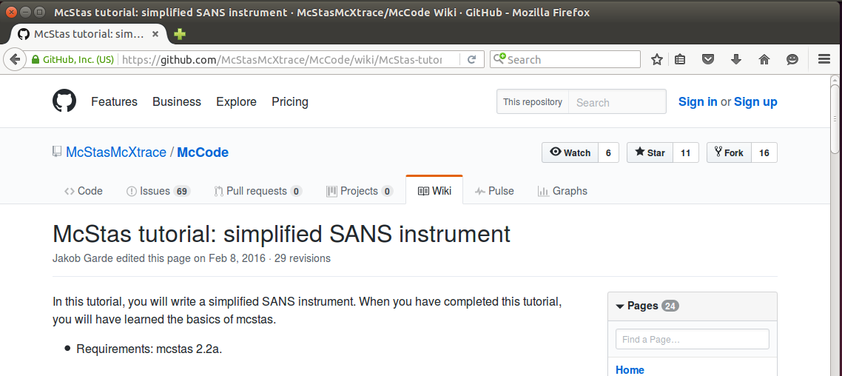
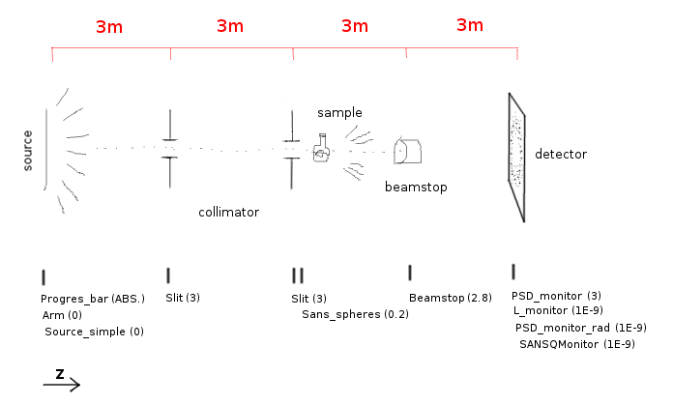
Illustration: simplified SANS instrument
October 2018
ORNL McStas workshop, October 18th-19th 2018

Slide 6
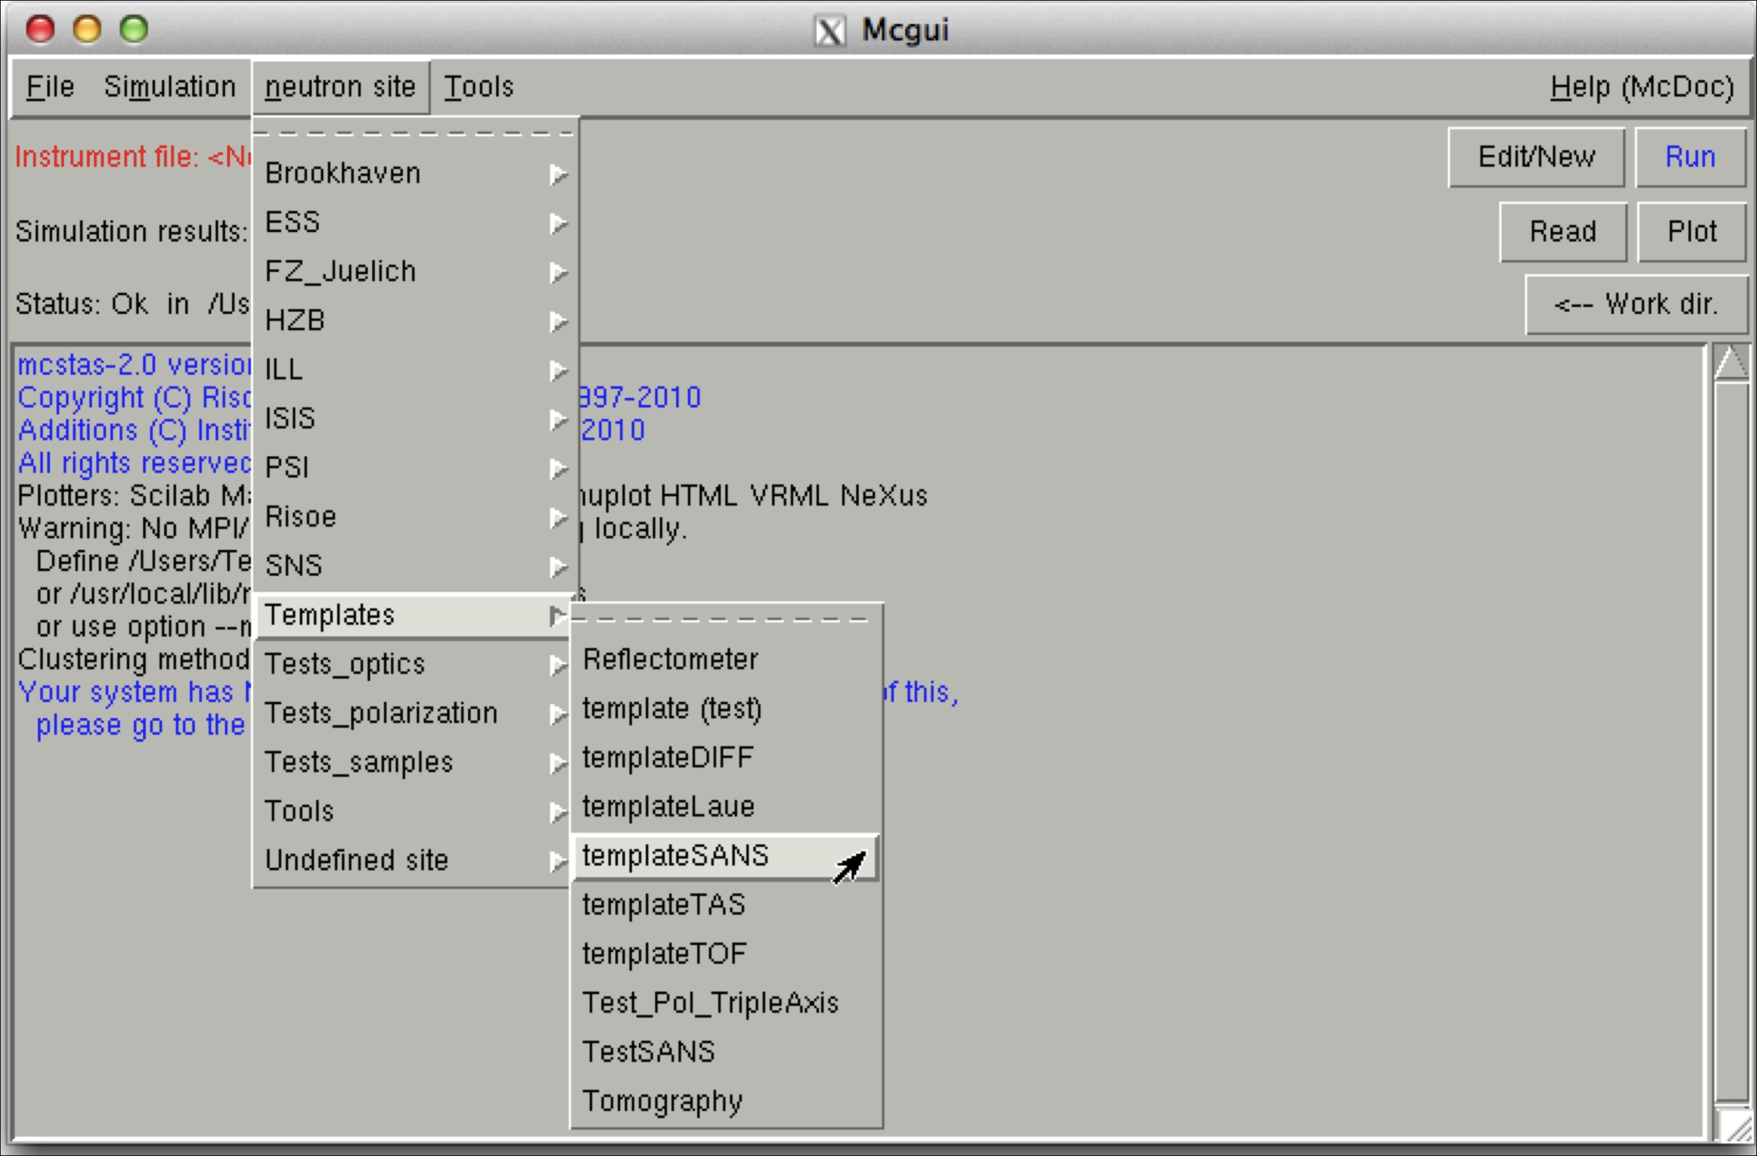
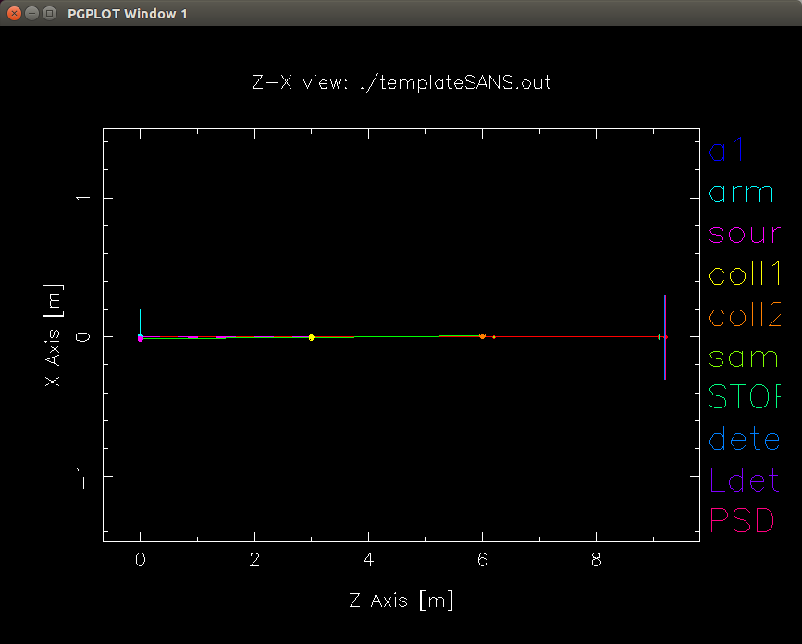
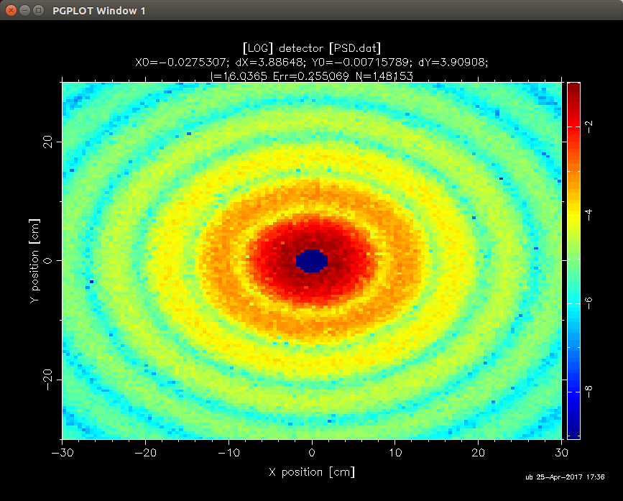
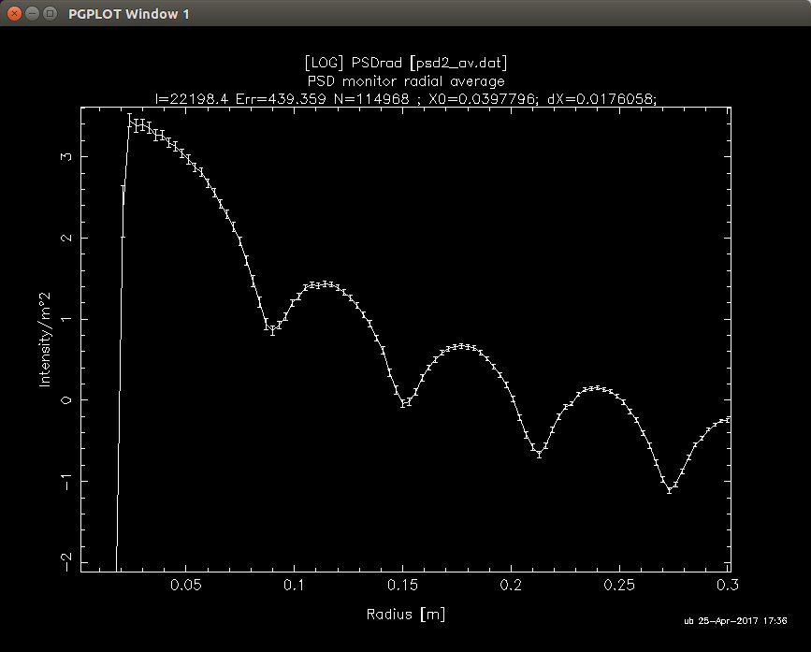
McStas GUI: templateSANS
October 2018
R=150,phi=0.1, d=1,a=0
ORNL McStas workshop, October 18th-19th 2018

Slide 7
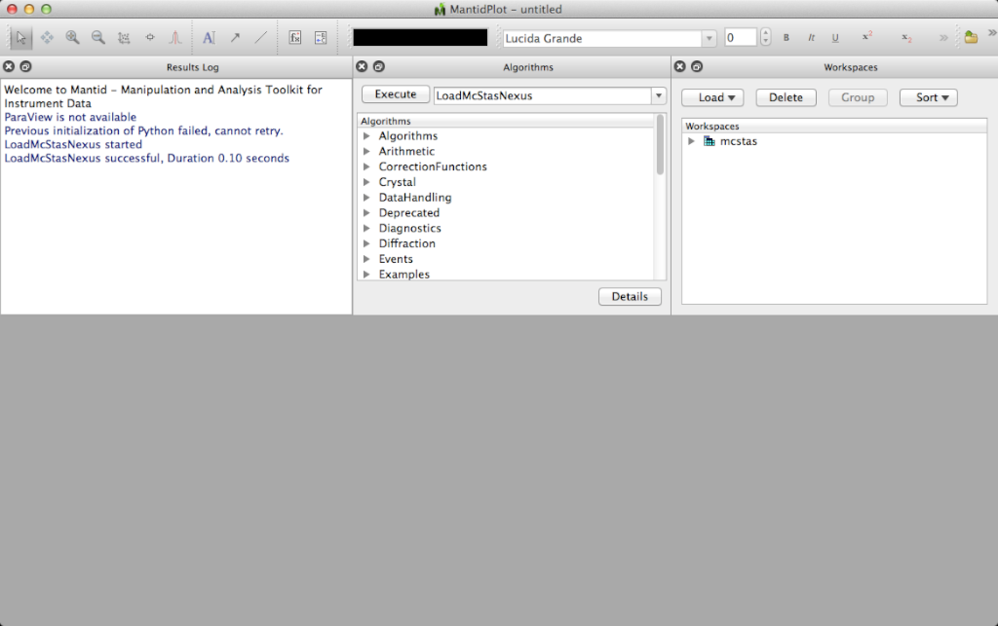
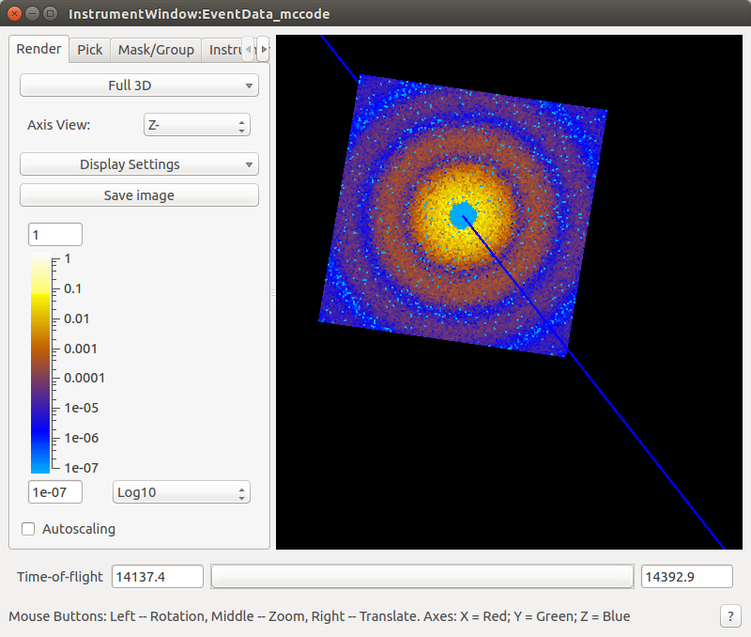
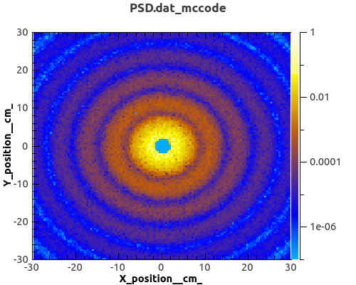
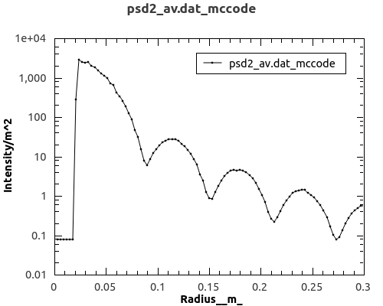
Mantid GUI: templateSANS McStas data
October 2018
ORNL McStas workshop, October 18th-19th 2018

Slide 8
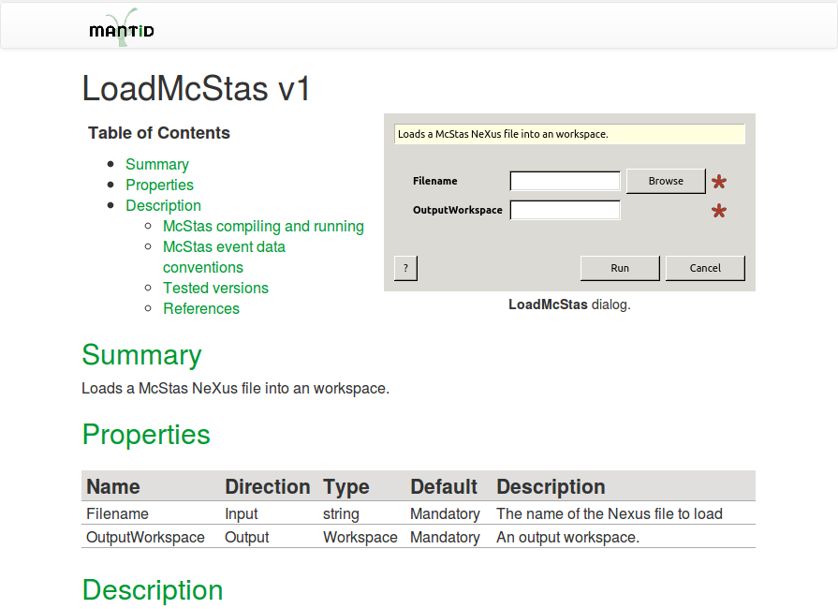
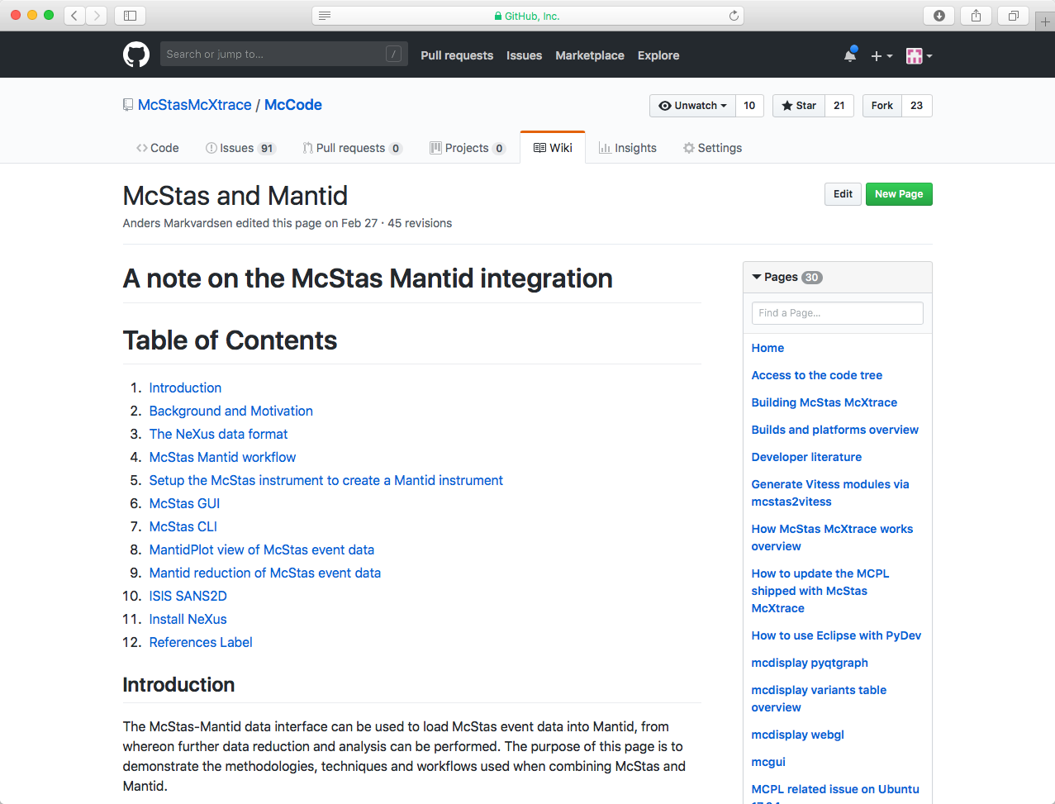
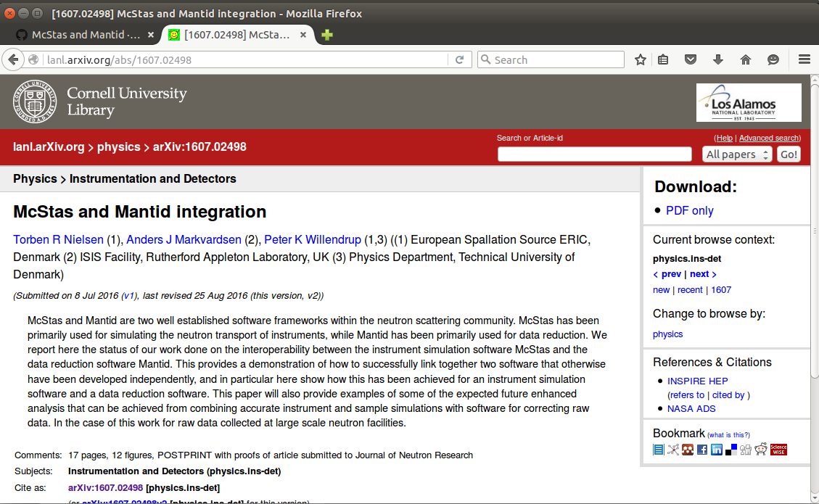
How to use: Online documentation
Github McStas - Wiki
Nielsen, T. R.; et. al JNR 18 2015, p. 79-92.
Archive https://arxiv.org/abs/1607.02498
Built-in Mantid
October 2018
ORNL McStas workshop, October 18th-19th 2018

Slide 9
TOF and pixel ID’s
October 2018
Mantid was designed for data reduction at TOF spallation neutron sources
Mantid’s IDF store geometry information use in TOF analysis
This implies parsing information about:
where the neutron source is located,
where the sample is located,
where each individual detector pixel is located.
ORNL McStas workshop, October 18th-19th 2018

Slide 10


The NeXus file
October 2018
NeXus file
Mantid
The McStas Nexus file must contain:
Event data, i.e each neutron has a pixel id and a time stamp
An IDF McStas monitor_nD gives pixle id & time for each event
mcdisplay can auto-generate an IDF
ORNL McStas workshop, October 18th-19th 2018

Slide 11
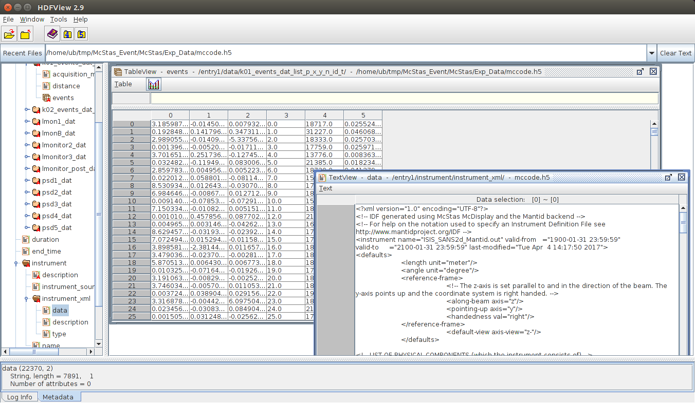
McStas NeXus file
October 2018
Event data
IDF xml data
ORNL McStas workshop, October 18th-19th 2018

Slide 12
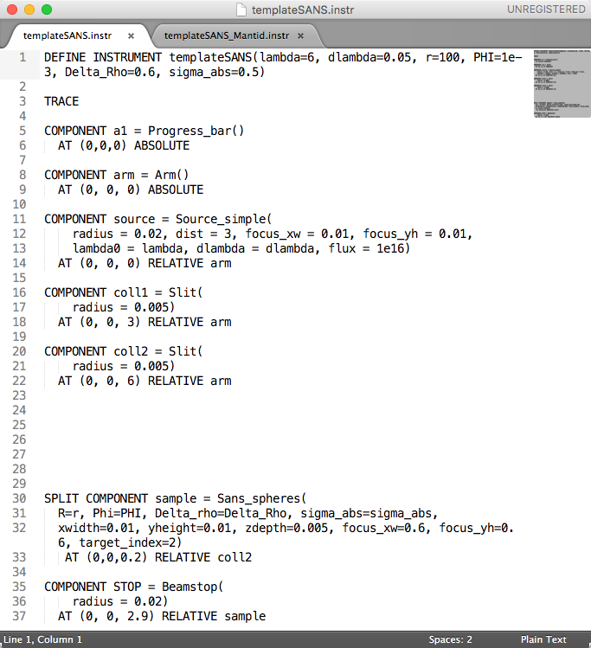
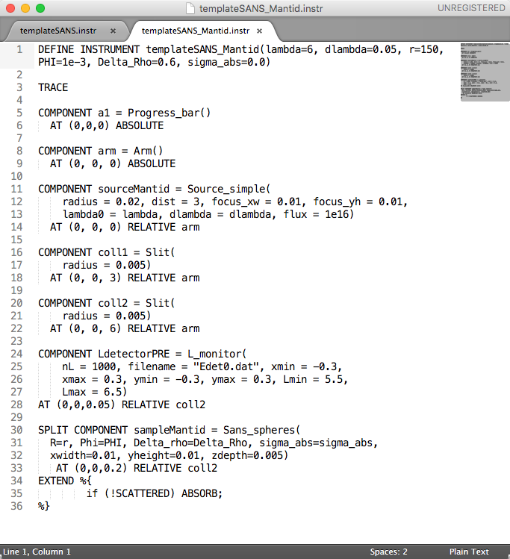
templateSANS.inst vs templateSANS_Mantid.inst
October 2018
ORNL McStas workshop, October 18th-19th 2018

Slide 13
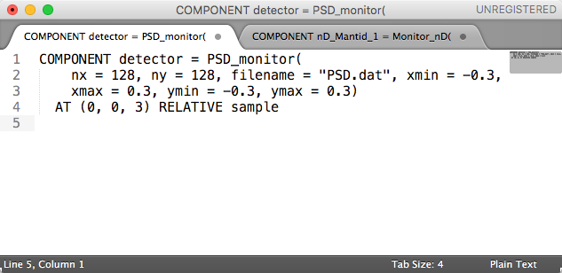
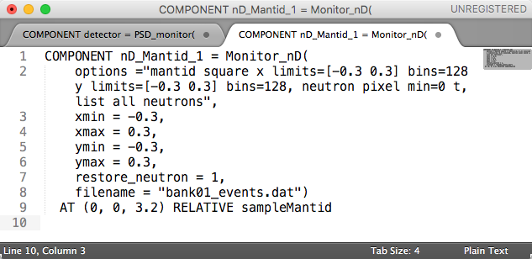
templateSANS.inst vs templateSANS_Mantid.inst
October 2018
ORNL McStas workshop, October 18th-19th 2018

Slide 14
McStas event KEYWORDS
October 2018
McStas instrument file name and the McStas defined name of the instrument must be the same:
E.g. templateSANS_Mantid.instr and “DEFINE INSTRUMENT templateSANS_Mantid(…. )”
In the McStas instrument file the source must be named “sourceMantid”
E.g. "COMPONENT sourceMantid = Source_simple(…. )"
In the McStas instrument file the sample must be named “sampleMantid”
E.g. "COMPONENT sampleMantid = Sans_spheres(…. )"
In the McStas instrument file the event monitors must be named “nD_Mantid_#”
E.g. "COMPONENT nD_Mantid_1 = Monitor_nD(…. )"
ORNL McStas workshop, October 18th-19th 2018

Slide 15
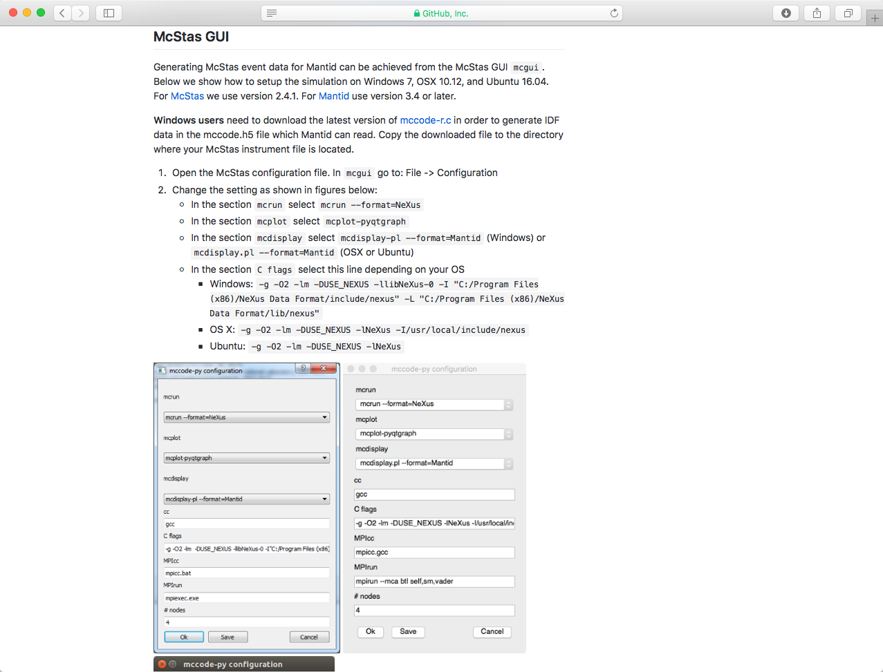
How to run simulation
October 2018
Wiki page on GitHub
ORNL McStas workshop, October 18th-19th 2018

Slide 16
McStas – Mantid: Demo Time
October 2018
See how to use Mantid – McStas interface
ORNL McStas workshop, October 18th-19th 2018

Slide 17
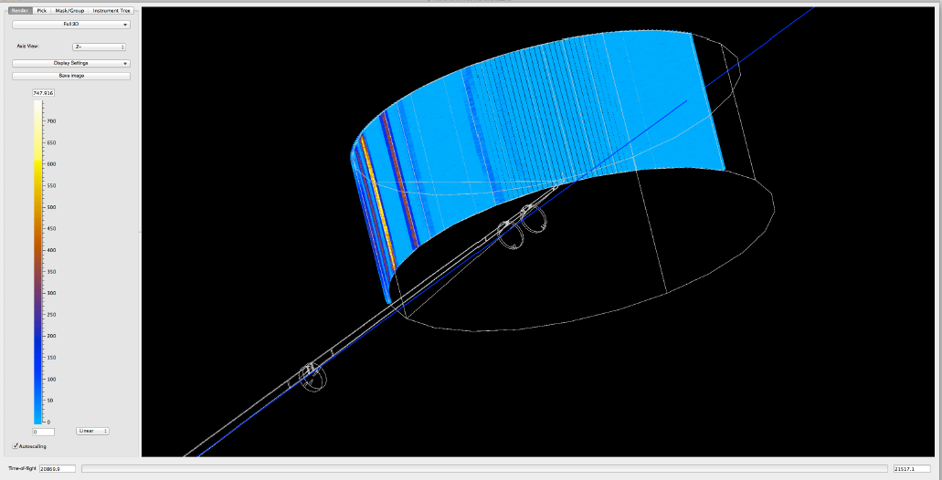
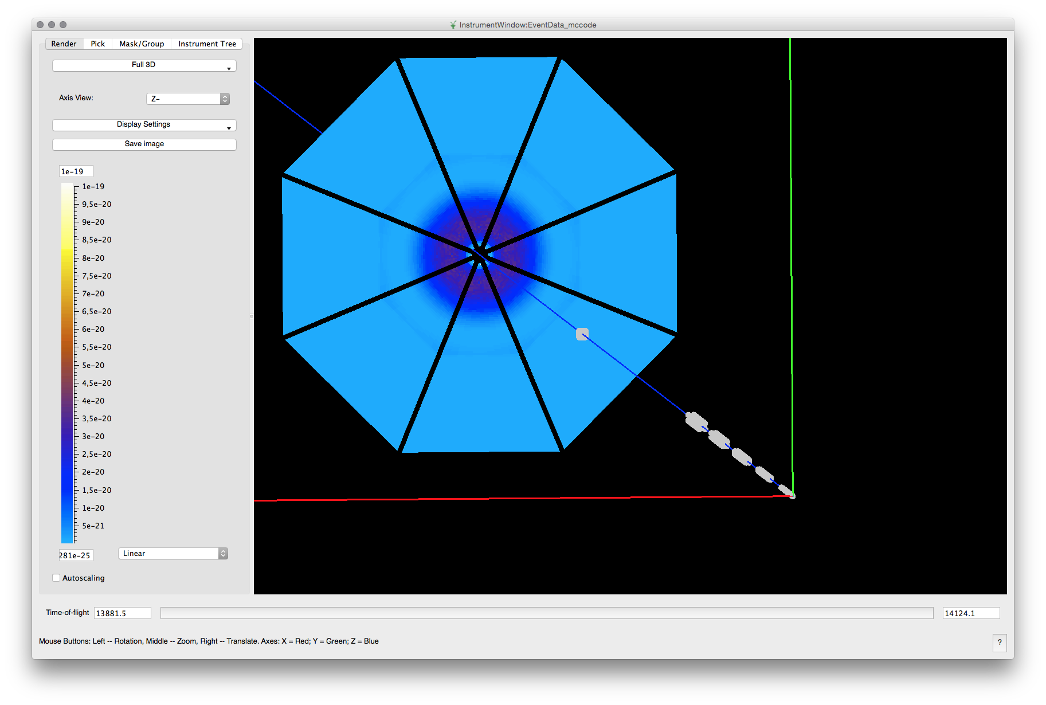
Examples of detectors: IN5 (ILL) and LoKI (ESS)
October 2018
ORNL McStas workshop, October 18th-19th 2018

Slide 18
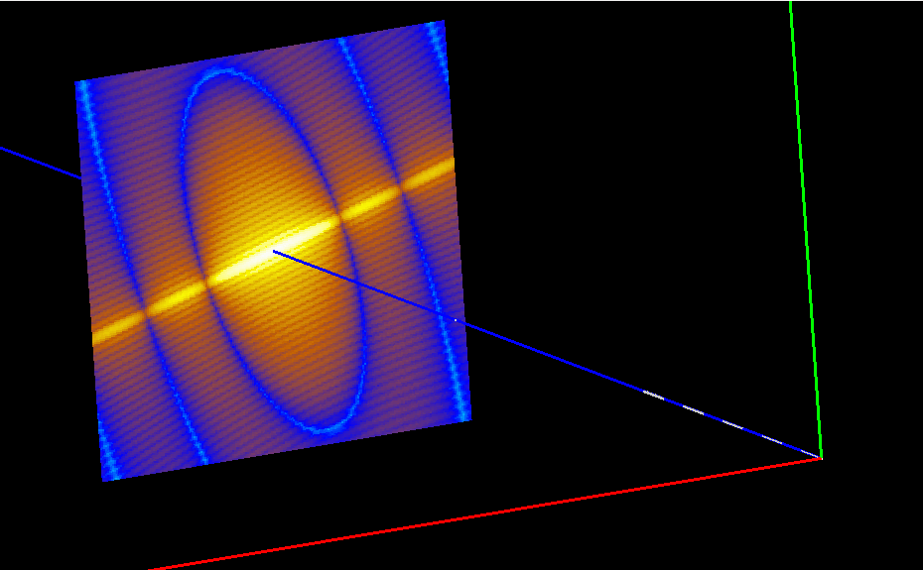
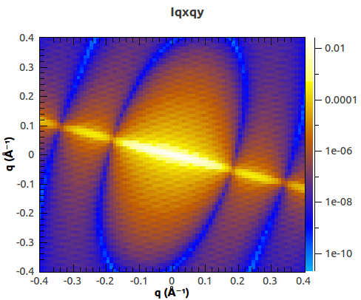
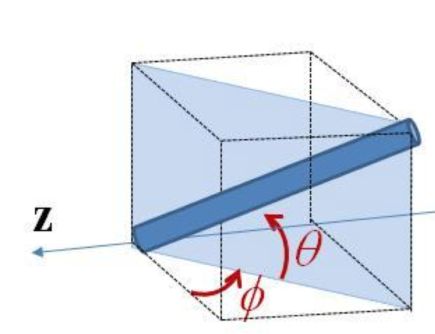
Example: Usage of Mantid algorithms
October 2018
McStas – Mantid
2D scattering kernel from SasView
2D reduction in Mantid: Qxy
Can be send back to SasView fitting
ORNL McStas workshop, October 18th-19th 2018

Slide 19
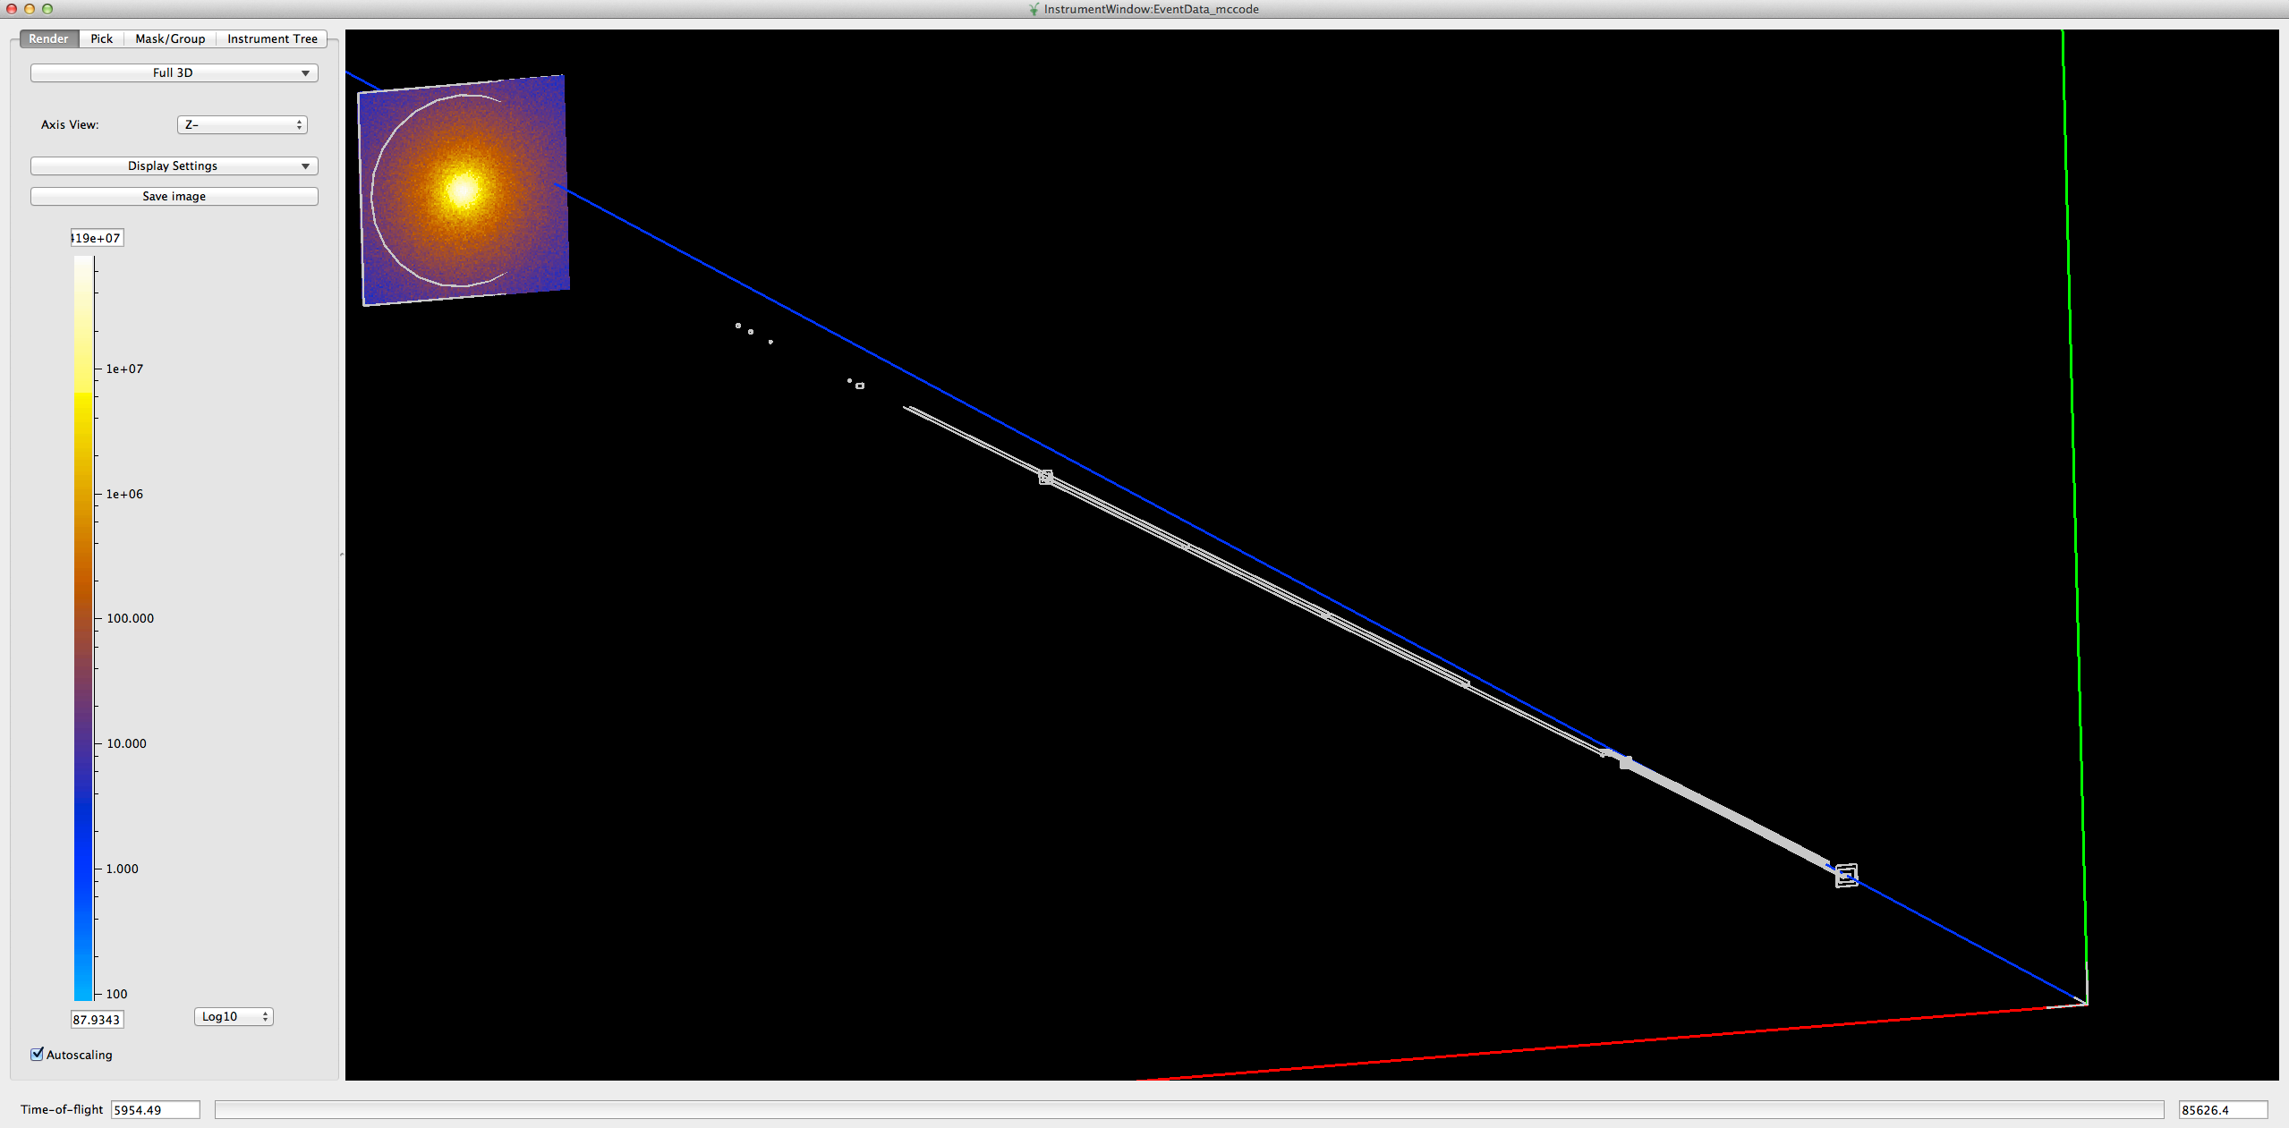
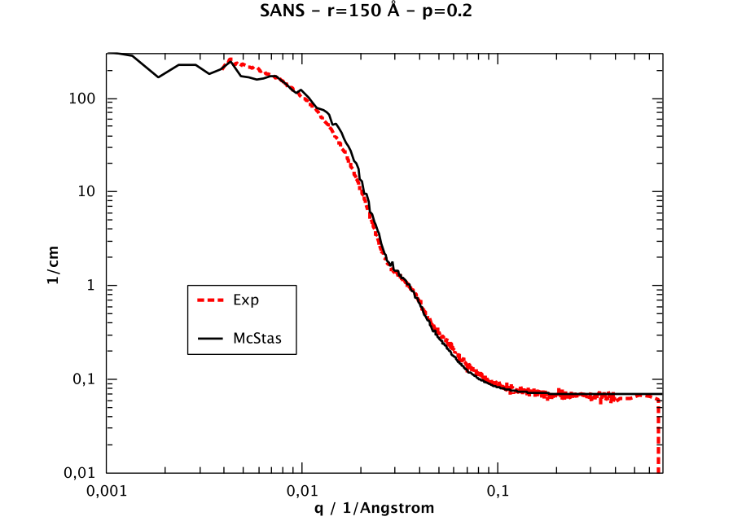
McStas and experimental data: SANS2D
October 2018
Mantid view of the McStas event data generated for the ISIS_SANS2d.instr file.
Comparison of rescaled scatting intensity I(q) derived from the experimental data and a McStas simulation. Nanospheres of radius 150 Å, polydispersion 0.2.
ORNL McStas workshop, October 18th-19th 2018

Slide 20
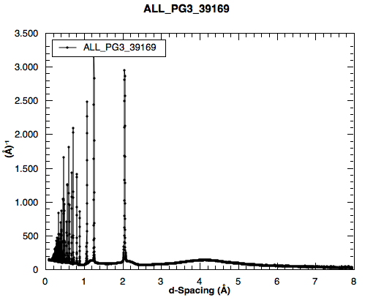
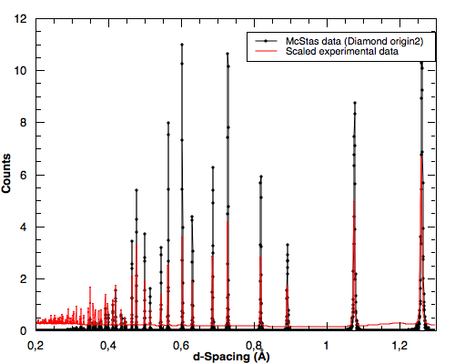
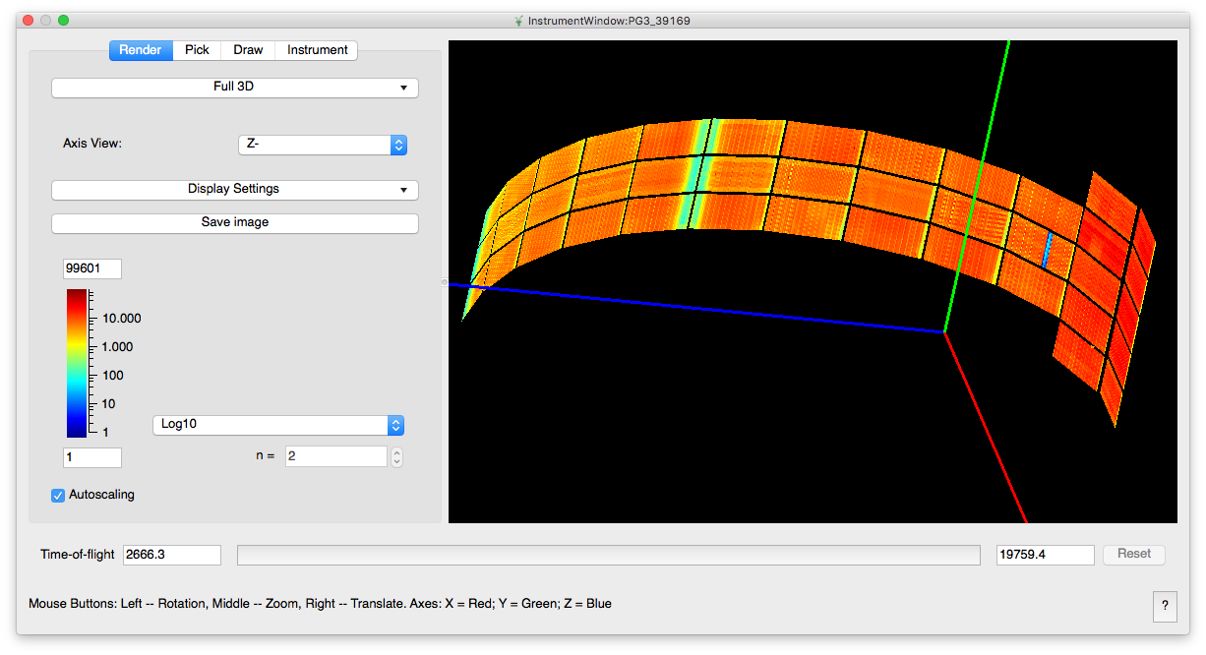
McStas and experimental data: POWGEN
October 2018
ORNL McStas workshop, October 18th-19th 2018
By CelineD @ ESS + SNS collaboration

Slide 21
McStas and experimental data: POWGEN
October 2018
ORNL McStas workshop, October 18th-19th 2018
By Celine D @ ESS + SNS collaboration

Slide 22
October 2018
The end …....
ORNL McStas workshop, October 18th-19th 2018

Slide 23
How to use: Generate the IDF
October 2018
How-to generate McStas event data for Mantid
Step 1. Generate IDF:
mcdisplay.pl templateSANS_Mantid.instr --format=Mantid -n0
A new xml IDF file is then generated on disk
ORNL McStas workshop, October 18th-19th 2018

Slide 24
How to use: Make NeXus file for Mantid
October 2018
How-to generate McStas event data for Mantid
Step 1. Compile c code:
gcc -o templateSANS_Mantid.out templateSANS_Mantid.c -DUSE_NEXUS –lNeXus –lm
Step 2. Run simulation:
templateSANS_Mantid.out --format=Nexus
Now IDF is embedded in the NeXus file to be read by Mantid
ORNL McStas workshop, October 18th-19th 2018

Slide 25
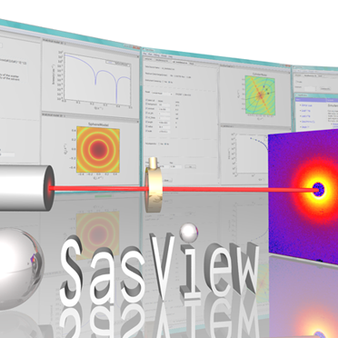
McStas interoperability
October 2018
Neutron transport
Reduction
Data analysis
Mantid
ORNL McStas workshop, October 18th-19th 2018

